Slide 1
Holland Circular Hotspot self service slide package Priority sectors and best practices
How to use the HCH slide package:
This presentation is made available for your use.
Please pick out the slides that fit CE in your region.
Always use the HCH logo and slogan ‘Sharing innovation’ in each slide.
If you have any questions or feedback, please contact us: info@hollandcircularhotspot.nl

Slide 2
Introduction
Presenter
Date Month Year

Slide 3
PRIORITY SECTORS In the Dutch transition agenda
Food and biomass
Plastics
Manufacturing industry
Construction
Consumer goods

Slide 4
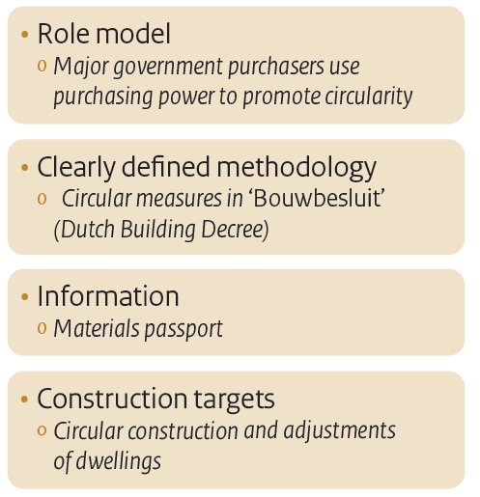
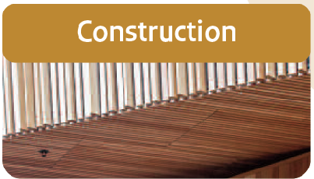
CONSTRUCTION Commitment and priorities

Slide 5
RIJKSWATERSTAAT – CIRCULAR PROGRAM
Rijkswaterstaat, the largest client in the Dutch construction sector, has the ambition to reduce primary raw materials use by 50% in 2030
www.rijkswaterstaat.nl

Slide 6
BIOBASED BRIDGE
World’s first bridge made of 100% biobased composite materials
www.biobasedbrug.nl

Slide 7
MODULO UPCYCLE CENTRE
The flexible construction method, enables the waste site to be adapted, relocated and reused over time
www.modulo-milieustraten.nl

Slide 8
VENLO CITY HALL
Designed according the cradle-to-cradle principles, collaboration was a key point to make the circular ambitions a reality
www.c2cvenlo.nl

Slide 9
PARK 2020 - INDUSTRIAL PARK
The focus on the well-being of people , inspired by Cradle to Cradle, resulted in an inspiring, healthy and productive work environment
www.park2020.com

Slide 10
MADASTER – MATERIAL PASSPORT
Using material passports, we can reuse building materials and eliminate waste
www.madaster.com/en

Slide 11
BLUE CITY – CIRCULAR INCUBATOR
For the office wing 90% of the materials used were of locally 'harvested' reused material
www.bluecity.nl

Slide 12
C-BÈTA – CIRCULAR BUSINESS CENTRE
An old farm was transformed in a ‘circular paradise’ with the use of discarded and circular materials and products
www.c-beta.nl

Slide 13
CIRCL – CIRCULAR PAVILLION
Many construction parts are made of second life materials. The wooden framework and other part are constructed for optimal re-use
www.circl.nl

Slide 14
RAU ARCHITECTS – LIANDER OFFICE
Several old buildings were transformed into one new office with 80% of the on-site material reused
www.rau.eu

Slide 15
THE MOBILE FACTORY
Rubble from natural disasters is shaped in large ‘Lego’ bricks and so regenerated for new buildings
www.themobilefactory.org

Slide 16
SMARTCRUSHER – CONCRETE RECYCLING
Recovered cementstone can be reused directly CO2-free in the production of new concrete
www.slimbreker.nl

Slide 17
DENIMTEX - WALL COVERING
Textile fibers are processed into a sound-absorbing, moisture-regulating paste that is applied to walls and ceilings
www.denimtex.nl

Slide 18
TARKETT – CARPET TILES
Residual lime from the production of drinking water is used for the production of EcoBase carpet tiles
www.tarkett.nl

Slide 19
JOIN THE GLOBAL
CIRCULAR COMMUNITY
www.hollandcircularhotspot.nl
info@circularhotspot.nl

