Slide 1
Holland Circular Hotspot self service slide package Priority sectors and best practices
How to use the HCH slide package:
This presentation is made available for your use.
Please pick out the slides that fit CE in your region.
Always use the HCH logo and slogan ‘Sharing innovation’ in each slide.
If you have any questions or feedback, please contact us: info@hollandcircularhotspot.nl

Slide 2
Introduction
Presenter
Date Month Year

Slide 3
PRIORITY SECTORS In the Dutch transition agenda
Food and biomass
Plastics
Manufacturing industry
Construction
Consumer goods

Slide 4
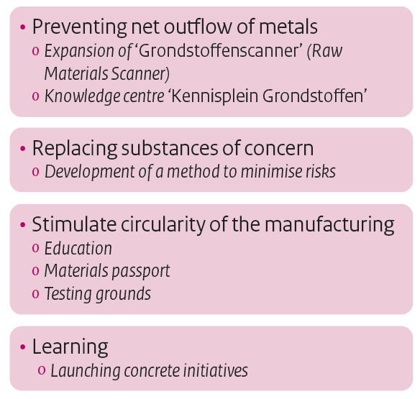
PRIORITY SECTOR MANUFACTURING INDUSTRY Commitment and priorities

Slide 5
FAIR METER – SMART ENERGY METER
A smart energy meter made from responsibly sourced, reusable materials
www.fairsmartmeter.com

Slide 6
PHILIPS HEALTHCARE - REMANUFACTURING
By keeping vital parts in the chain, high-quality equipment with full warranty can be provided at a lower cost
www.philips.com/healthcare

Slide 7
BOLLEGRAAF – RECYCLING EQUIPMENT
Moving up the chain: from equipment manufacturer to recycling director
www.bollegraaf.com

Slide 8
ZERO BRINE – MINERALS RECOVERY
Eliminate industrial saline wastewater streams by recovering and reusing the minerals and water from the brine used in other industries
www.zerobrine.eu

Slide 9
SEW EURODRIVE - REMANUFACTURING
The company remanufactures around 2,000 used drive units per year
www.sew-eurodrive.nl

Slide 10
SNEW – ICT REFURBISHMENT
200,000 refurbished IT-products are sold per year with a buy back guarantee after five years
www.snewserviceparts.com

Slide 11
LEAPP – ICT REFURBISHMENT
By giving a second life to tens of thousands Apple products per year, leapp decreases the environmental impact of electronics
www.leapp.nl

Slide 12
CLOSING THE LOOP – MATERIAL OFFSETTING
Around 4000 people were provided with extra income and over 50 tons of electronic waste were saved 'from the garbage dump'
www.closingtheloop.eu

Slide 13
CIRCO – CIRCULAR BUSINESS DESIGN TRACKS
Companies investigate innovative business models by applying circular design principles in a 3-day business course
www.circonl.nl

Slide 14
JOIN THE GLOBAL
CIRCULAR COMMUNITY
www.hollandcircularhotspot.nl
info@circularhotspot.nl

