Slide 1
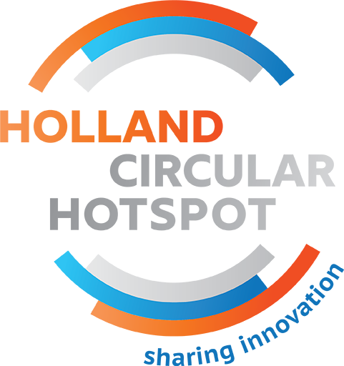
Best Practices
Plastics

Slide 2
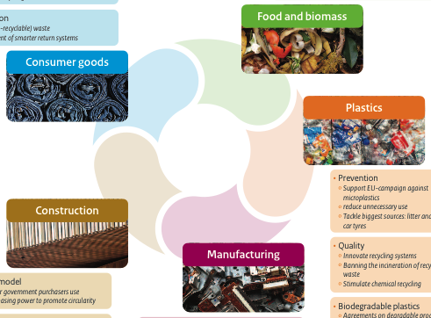

Slide 3
A circular economy in the Netherlands by 2050
Dutch commitment and priorities

Slide 4
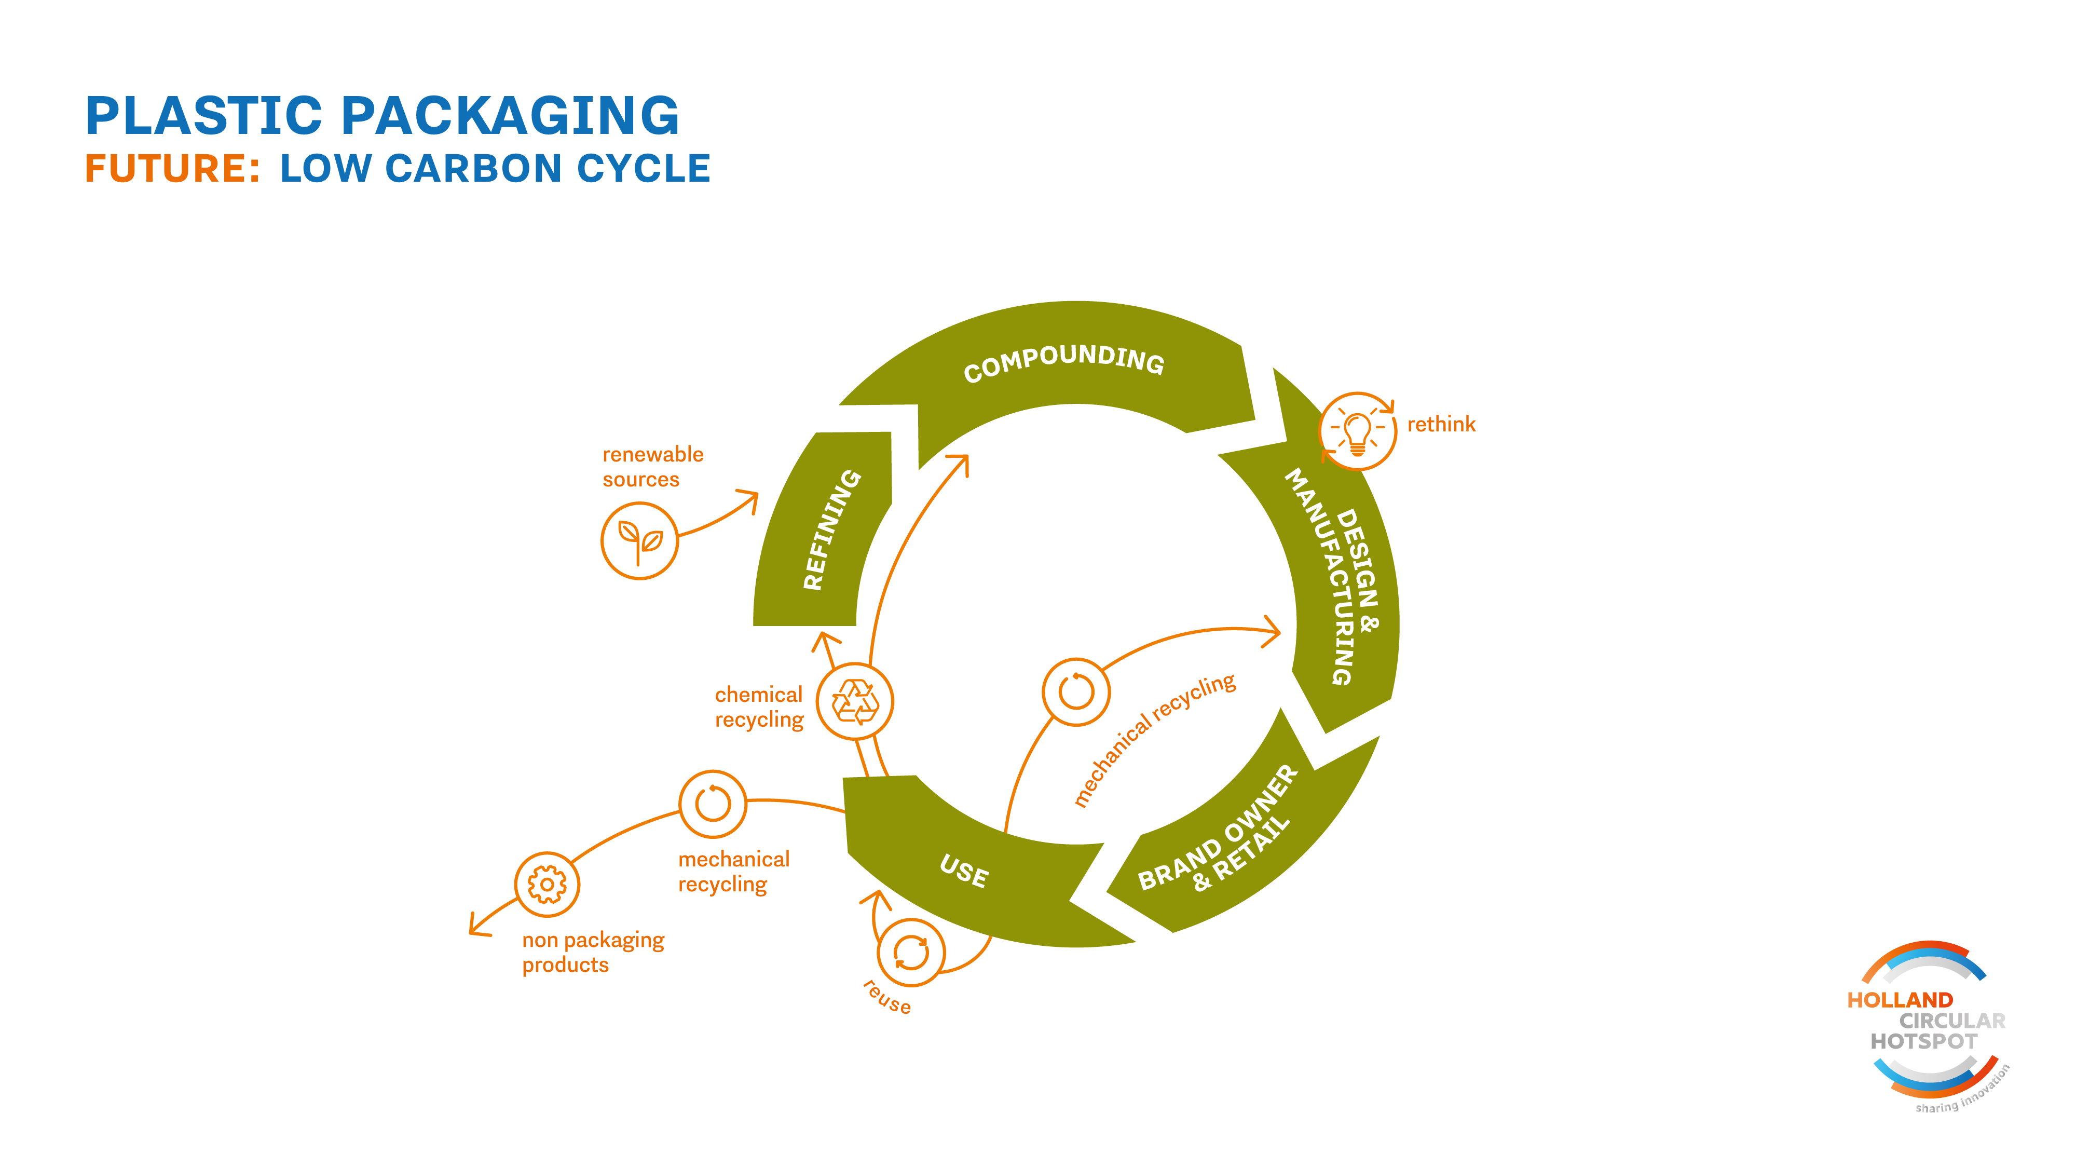

Slide 5
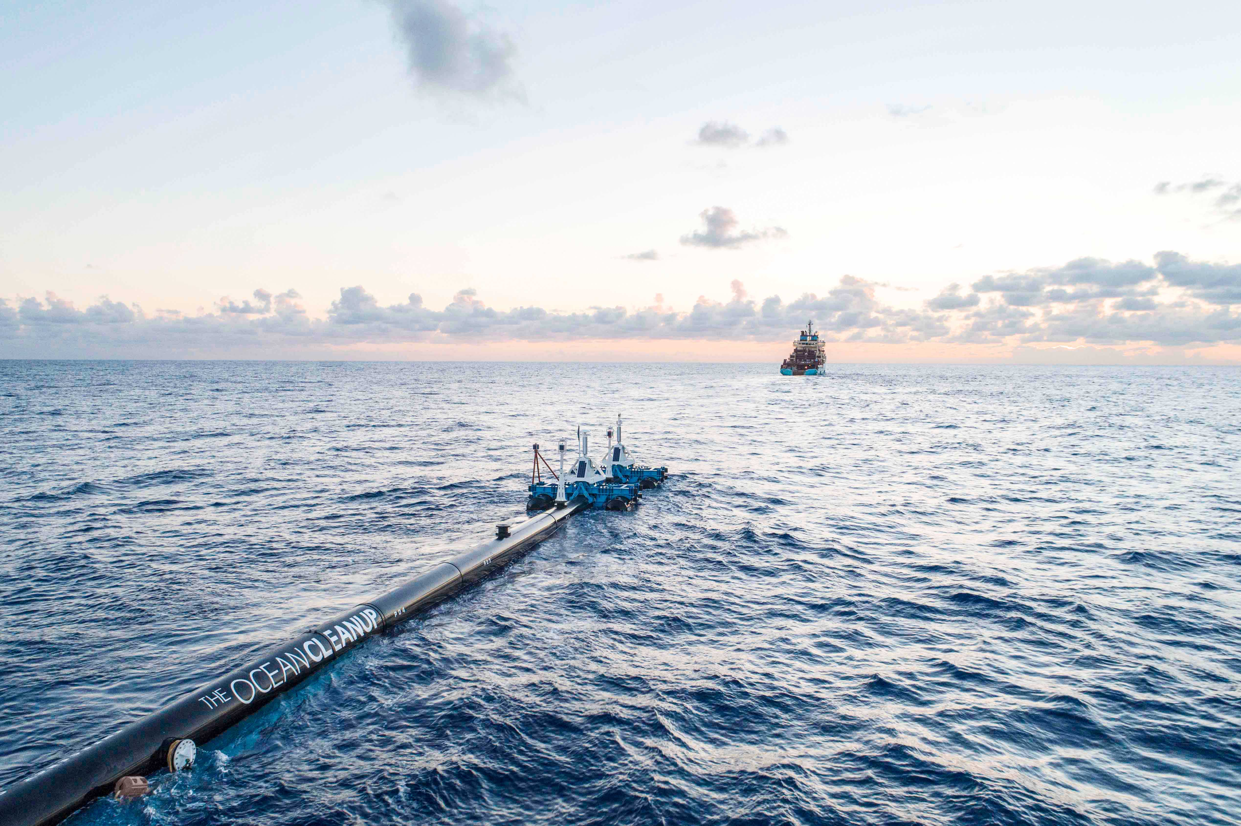
THE OCEAN CLEANUP
Long, floating barriers placed in the ocean currents direct the plastic into collection points
www.theoceancleanup.com

Slide 6
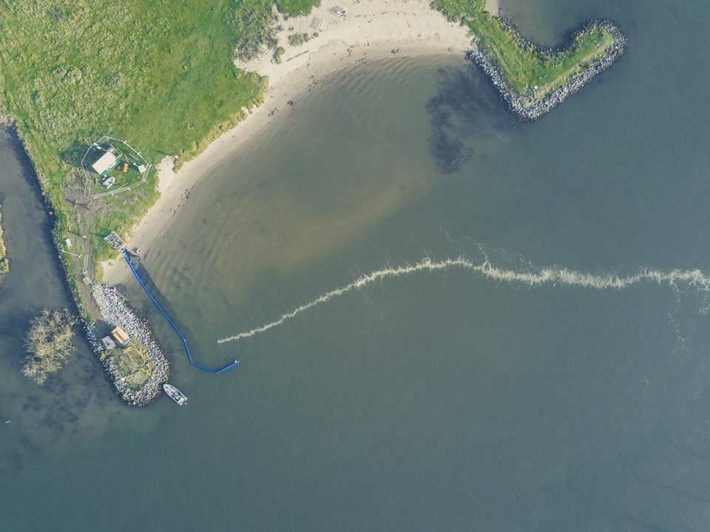
THE GREAT BUBBLE BARRIER
The wall of bubbles stops plastic pollution in rivers before it reaches the oceans but allows fish and ships to pass easily
www. thegreatbubblebarrier.com

Slide 7
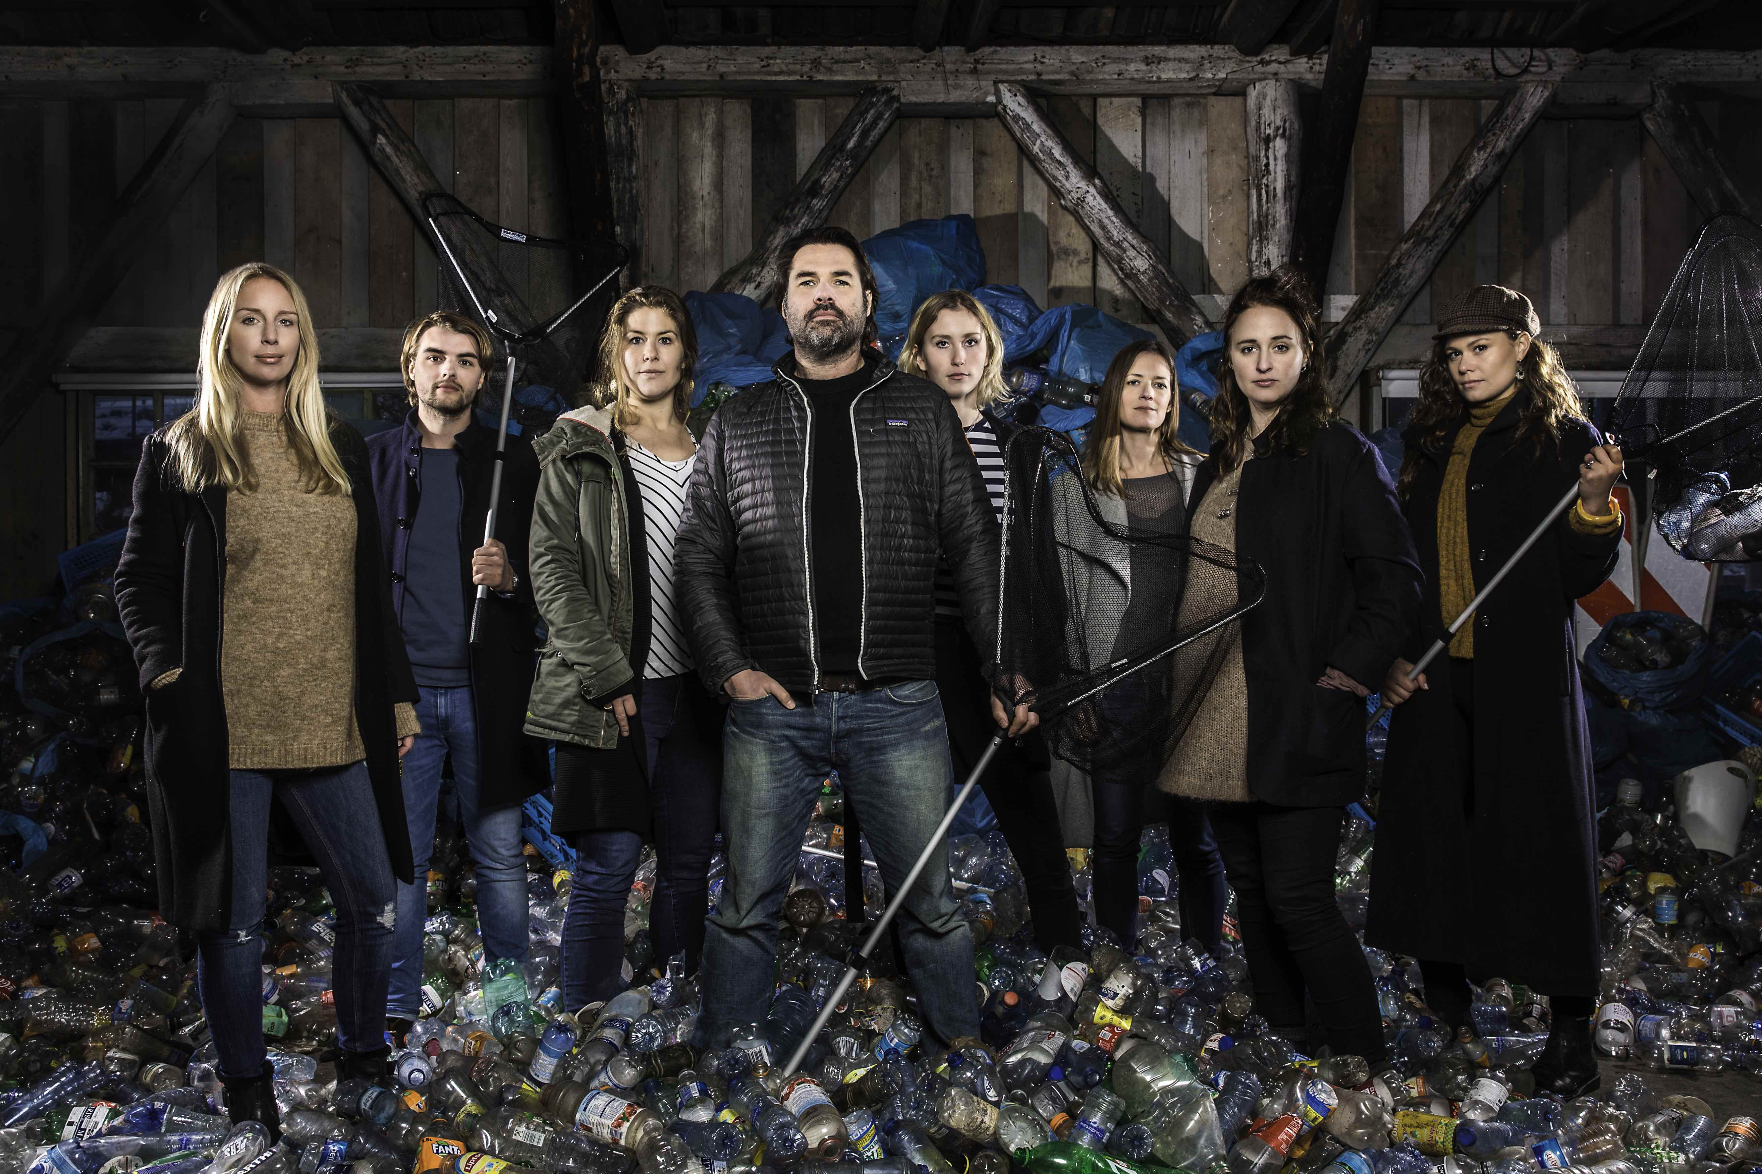
PLASTIC WHALE – WASTE FISHING
Over 12,500 plastic fishing people caught 105,000 bottles and filled 2,062 bin bags with plastic waste
www.plasticwhale.com

Slide 8
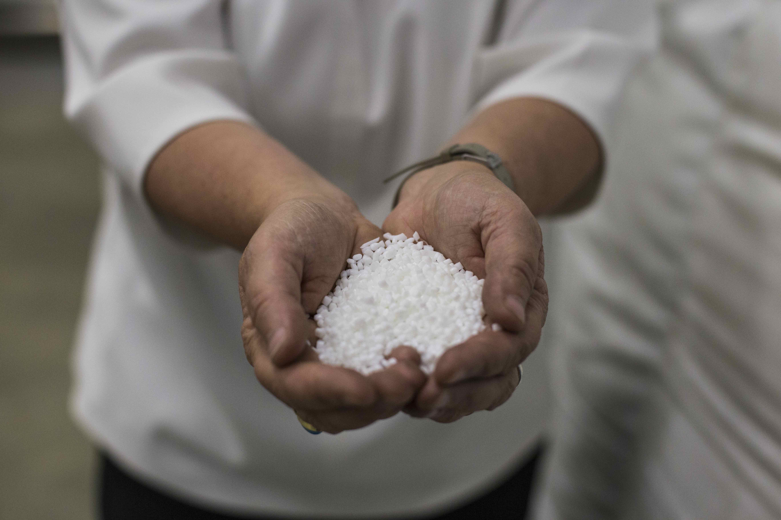
DSM NIAGA – RECYCLABLE CARPET MATERIAL
The carpet material can be fully restored to its original form in an economically viable way and without compromising on quality
www.dsm-niaga.com

Slide 9
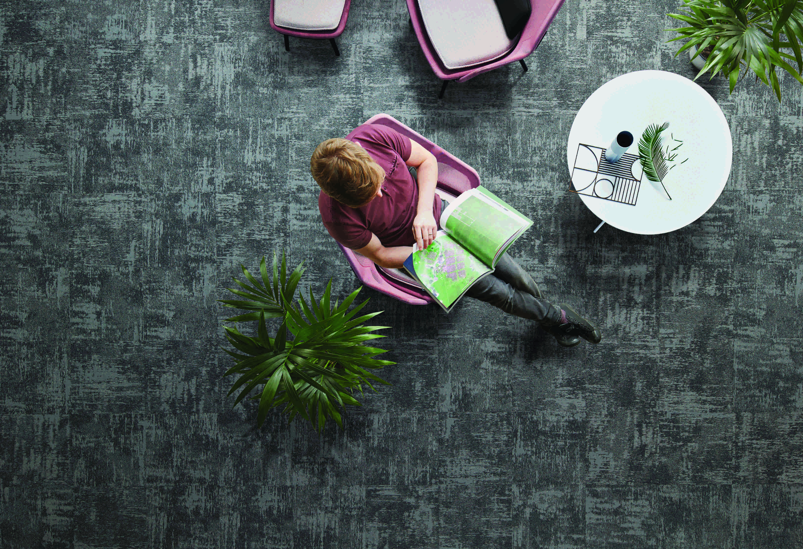
INTERFACE/NETWORKS-RECYCLED MATERIALS
85% of Interface’s raw materials are recycled or bio-based, discarded fishnets from poor coastal areas are used as resource
www.net-works.com

Slide 10
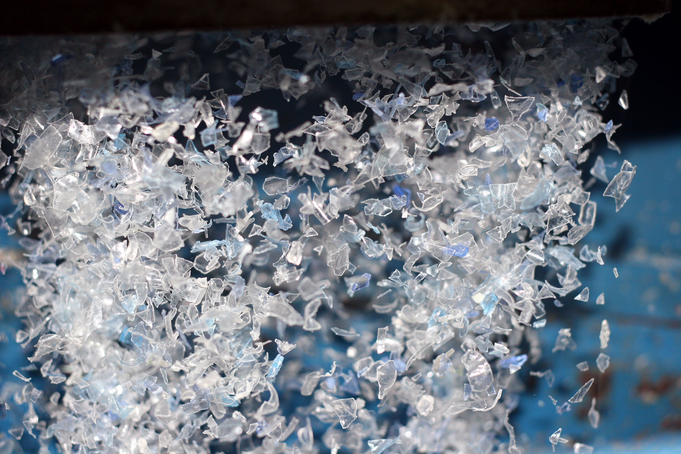
IONIQA – ‘EVERLASTING’ PLASTIC
Innovative process to convert all kinds and colours of plastic PET waste into high quality and colourless raw material
www.ioniqa.com

Slide 11
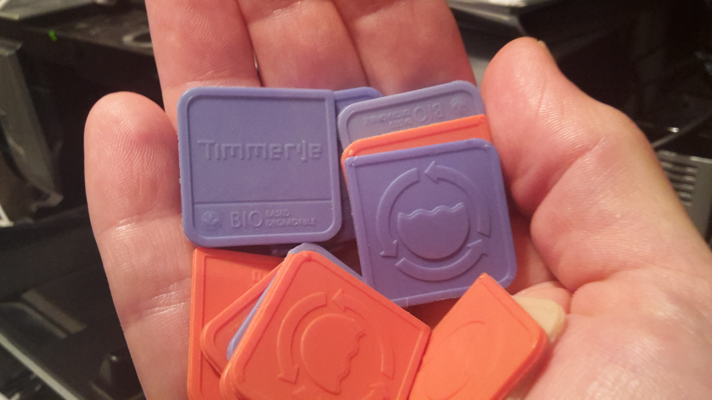
PHARIO – SEWAGE BIOPLASTICS
Using bacteria to produce PHA bioplastic from sewage water, turning waste water into a source of materials
www.efgf.nl/english
Notes:
The regional water authorities
in the Netherlands no longer
regard wastewater only as a
waste product to be treated
and processed, but also as a
source of sustainable energy,
raw materials and clean water.
One of those raw materials
is a bioplastic produced by
bacteria from wastewater:
PolyHydroxyAlkanoate or PHA.
PHA has excellent proven
technical properties and is
biodegradable under certain
conditions.
This fits in with regional water
authorities’ social transition
towards a circular economy,
which it is working on in the
network organisation Energie- en
Grondstoffenfabriek (Energy and
Raw Material Factory).
Bio-based and
biodegradable plastic
The processes required for
purifying sewage water breed
the right bacteria for making
PHA bioplastic. If you offer these
bacteria enough food under the
right conditions, they produce up
to 40% to 50% of their own weight in
PHA bioplastic.
This plastic has very good
thermal and mechanical
properties making it suitable
for all kinds of applications. It
is also biodegradable and more
importantly, it is globally scalable,
as most classic waste water
treatment plants can implement
the same processes.
In the Phario pilot project in
2017, the Dutch regional water
authorities successfully showed
how to make a PHBV (a PHA variant)
from sludge and fatty acids. PHBV
has a 70% lower environmental
impact than PHA of monocultures
and a competitive market price in
the PHA family.

Slide 12
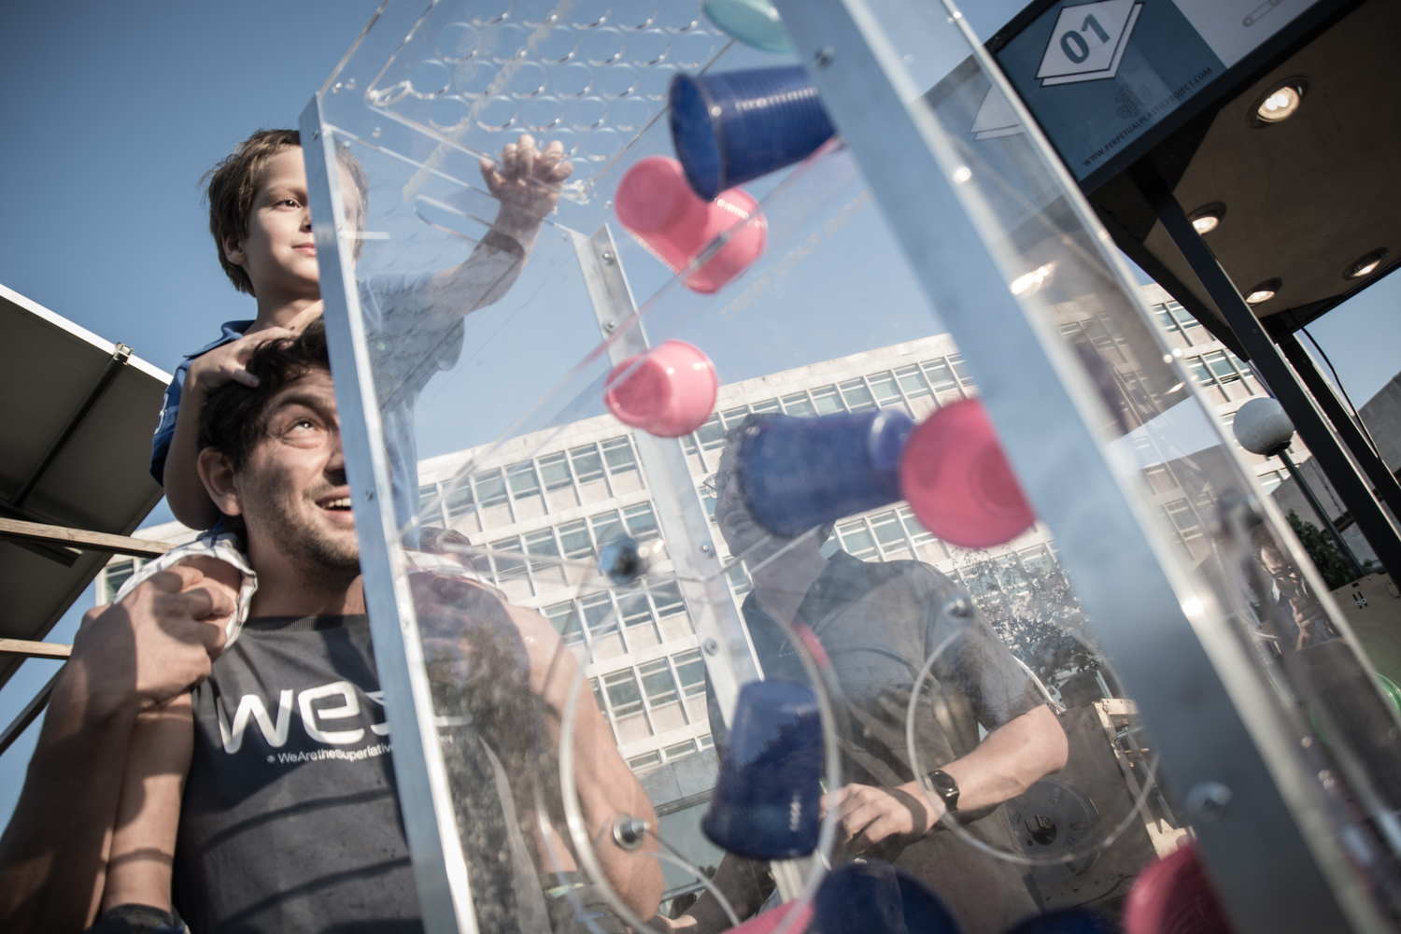
PERPETUAL PLASTIC – MOBILE RECYCLING LAB
Giving the public hands-on experience in turning their used plastic cups into new products through 3D printing
www.perpetualplasticproject.com

Slide 13
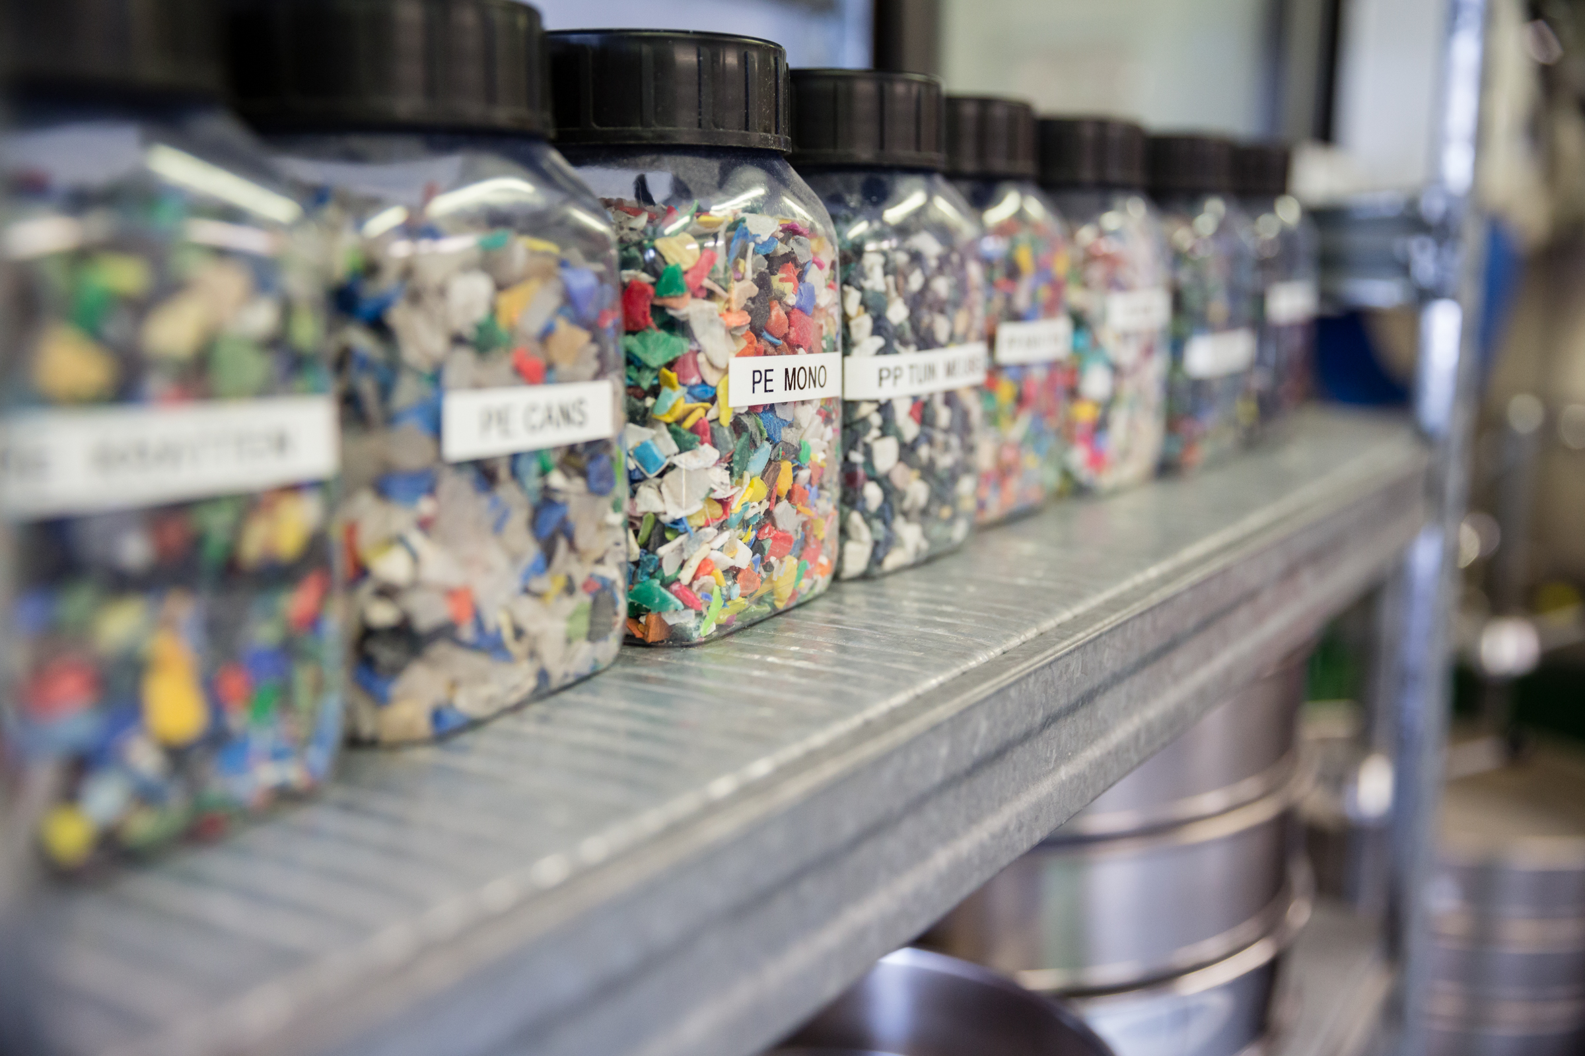
VAN WERVEN – RIGID PLASTICS RECYCLING
Creating high quality materials from post-consumer hard plastics
www.recyclingplastics.eu

Slide 14
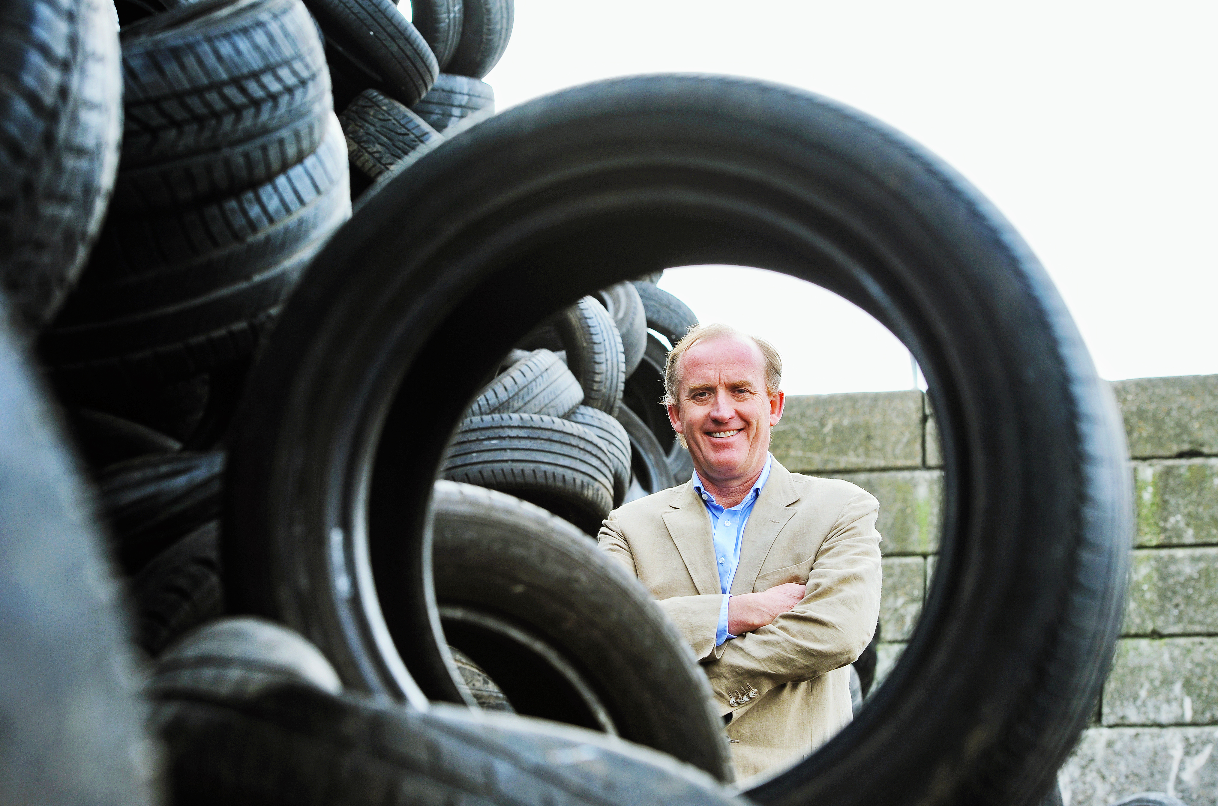
BLACK BEAR CARBON
Harvests and upcycles the carbon black from end-of-life tires to a quality level that exceeds that of the original product
www.blackbearcarbon.com

Slide 15
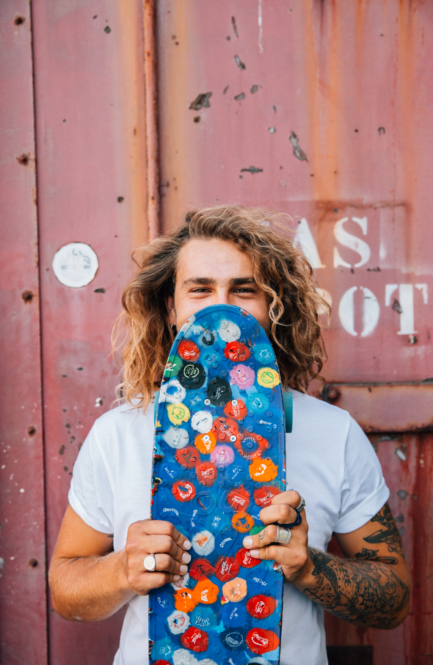
WASTEBOARDS – RECYCLED BOTTLE CAPS
Unique handmade skateboards of recycled plastic bottle caps
www.wasteboards.com

Slide 16
JOIN THE GLOBAL
CIRCULAR COMMUNITY
www.hollandcircularhotspot.nl
info@circularhotspot.nl

