Slide 1
CIRCULAR ECONOMY & THE SOCIAL DEVELOPMENT GOALS
Version 2020

Slide 2
CIRCULAR ECONOMY & SELECTED SDGs
‘Achieving the Global Goals opens up US$12 trillion of market opportunities in the four economic systems food and agriculture, cities, energy and materials, and health and well-being)’

Slide 3
CIRCULAR ECONOMY & SDG 6: ENSURE AVAILABILITY AND SUSTAINABLE MANAGEMENT OF WATER AND SANITATION FOR ALL

Slide 4
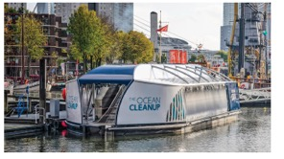
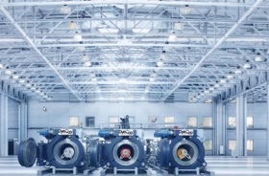
CIRCULAR ECONOMY & SDG 6: ENSURE AVAILABILITY AND SUSTAINABLE MANAGEMENT OF WATER AND SANITATION FOR ALL
THE OCEAN CLEANUP
FOSVAATJE
DYECOO

Slide 5
CIRCULAR ECONOMY & SDG 7: AFFORDABLE AND CLEAN ENERGY

Slide 6
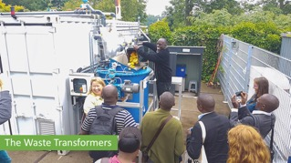
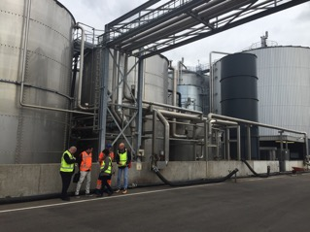
CIRCULAR ECONOMY & SDG 7: AFFORDABLE AND CLEAN ENERGY
WASTE TRANSFORMERS
GREENMILLS, RENEWI
MINI MOTO COOKSTOVE
SMART CRUSHER

Slide 7
ZOOMING IN ON ANEAROBIC DIGESTION GLOBAL POTENTIAL
GHG emissions reduction
Coal substitution
Inorganic fertiliser substitution
Notes:
7

Slide 8
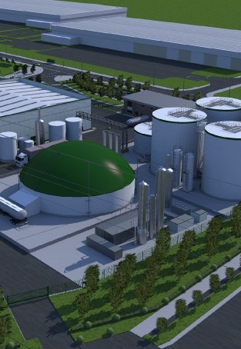
REALISING THE POTENTIAL OF ANAEROBIC DIGESTION
POLICY OPTIONS TO STIMULATE THE AD MARKET
Removal of fossil fuel subsidies
Net zero emissions by 2040
Biogas targets in energy plans
AD in GHG abatement targets
Renewable energy incentives
Enabling safe trading and use of digestate
Circular economy strategies
Preferred method of treatment
Food waste management requirements for businesses
Nutrient recovery plans for farms
Improved sanitation infrastructure
Separate food waste collections for citizens
Sustainability and GHG criteria for agricultural production
Govt. spending on biomethane infrastructure
JOIN US NOW AND BE PART OF THE BIOGAS REVOLUTION!
www.worldbiogasassociation.org
Notes:
Let’s discuss
8

Slide 9
FINAL REMARKS

Slide 10
TAKE AWAYS
Circular Economy is happening today
Front-running businesses are embracing it
It is happening in developed and developing countries
It is an opportunity, it is about future markets and continuity
We need to innovate and scale up fast, but businesses can’t do it alone
We need involvement of all actors

Slide 11
AFRICAN PROVERB
“IF YOU WANT TO GO FAST GO ALONE,
IF YOU WANT TO GO FAR GO TOGETHER”

Slide 12
JOIN THE GLOBAL
CIRCULAR COMMUNITY
www.hollandcircularhotspot.nl
info@circularhotspot.nl

